Slide 1

Let's talk homelessness
A listening session to inform the community's strategic plan
Knoxville-Knox County Office of Housing Stability
Winter 2024/2025

Slide 2

Ice Breaker
What is your greatest joy?
  Family
  Partner
  Friends
  Work
  Church
  Home
  What else?

Slide 3

Background
Your input will help shape a five-year strategic plan
Overarching goal is to reduce homelessness
Plan available in spring 2025 at knoxtnhousing.org

Slide 4

Continuum of Care
Please consider joining the membership of the Knoxville-Knox County Continuum of Care
This is a venue for conversations about improving our homeless services system
Invitation will be officially issued in the new year
Please email office@knoxtnhousing.org if you'd like to receive email updates

Slide 5
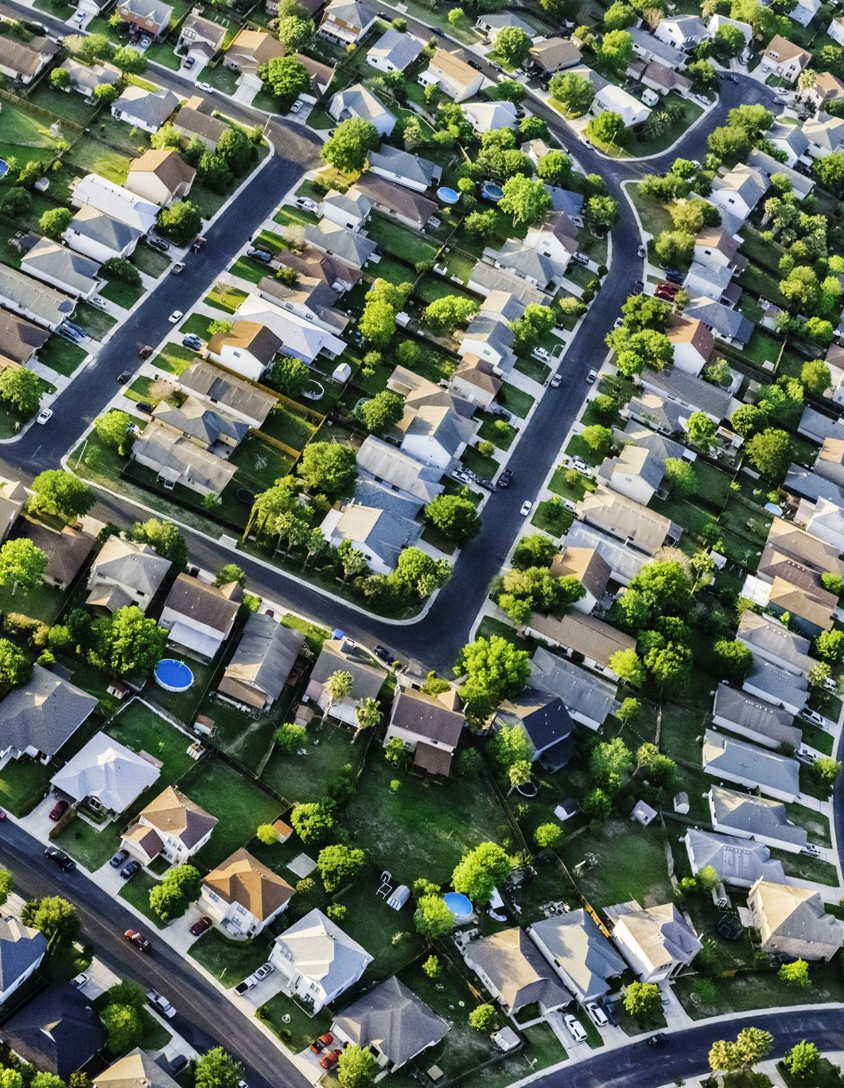
High housing costs = more homelessness
High housing costs correlate with high homelessness rates
People who spend more than 30% of income on housing are at higher risk of becoming homeless
4 in 10 renter households in the Knoxville metro area must spend 30% or more of their income to stay housed

Slide 6

Homelessness increasing
In 2018, appr. 1,000 people accessed homeless services in Knoxville and Knox County on an average day
In 2024, it's 1,800 people
72% of people who became homeless in Q2 this year identified one of the following as the reason: eviction, lack/loss of employment, or cannot find affordable housing

Slide 7
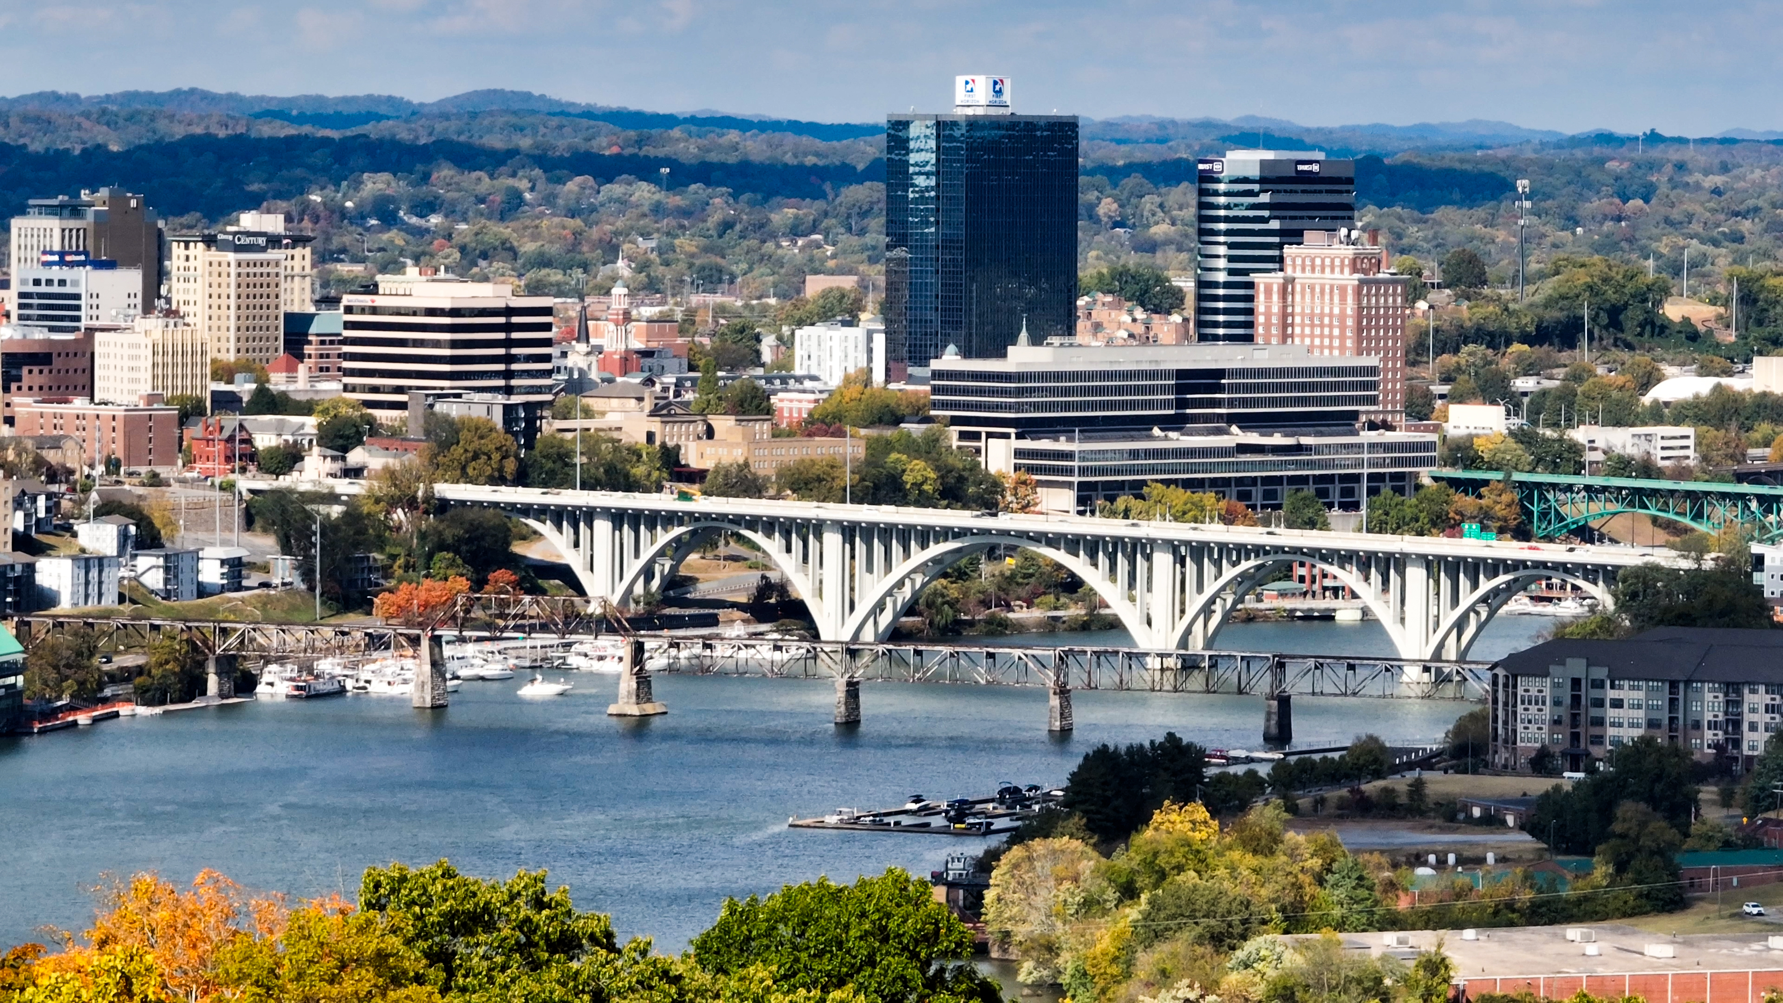
But aren't they all coming from other places?
75% of people who became homeless in Q2 this year were from here: from Knoxville and/or Knox County

Slide 8

Beyond housing: drivers/consequences of homelessness
Homelessness is a housing problem
And we must also address:
  Mental illness
  Substance misuse
  Domestic violence
  Human trafficking
  Family conflict

Slide 9

Remember our ice breaker?
Homelessness is the loss of every one of these.
  Family
  Partner
  Friends
  Work
  Church
  Home
  What else?

Slide 10
Let's talk
Ground rules:
  Hold respectful space for different experiences and opinions
  Our goal today is to listen, not to solve
  Share the airtime, please keep responses to 1 minute or less
Please type/write down all group members' answers and send to office@knoxtnhousing.org

Slide 11
Question 1: What does it mean to belong to the Knoxville/Knox County community?
What shared stories define us?

Slide 12
Question 2: How does homelessness impact you and your family? Your business or workplace?

Slide 13
Question 3: If you or a loved one were homeless, how would you want the community to help?

Slide 14
Question 4: Which of the following seven program types do you think are most important for our community?
What challenges and opportunities do you see?

Slide 15
Programs
Direct outreach
  Connects unhoused people to resources
Emergency shelter
  Like KARM
Upstream prevention
  Keeps people from becoming homeless in the first place (like Eviction Prevention Program)
Wrap-around services
  For ex., case management, mental health and substance abuse treatment
Temporary services
  Helps unhoused people get housed and move into self-sufficiency
Long-term supportive housing
  For unhoused people with disabling conditions
Increase housing stock
  At every price point, to take upward pressure off housing costs

Slide 16

Thank you!
Please send your written responses to office@knoxtnhousing.org
Go to knoxtnhousing.org for more opportunities to engage

